Slide 1
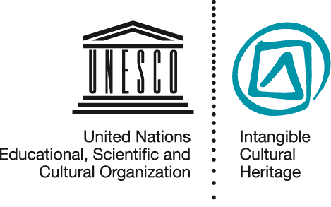
Involving the communities concerned
IMP 5.7
UNESCO
Intangible Cultural Heritage Section

Slide 2
In this presentation ...
Case study: what can go wrong
Why community participation
What the Convention and the ODs say
When community participation is needed
How to achieve community participation and consent

Slide 3
What can go wrong: the ICBG Maya project
Disputes over who constituted the community
Disputes over who represented the community
Disputes over how the community would benefit and
Disputes over what constituted community consent for the project to proceed

Slide 4
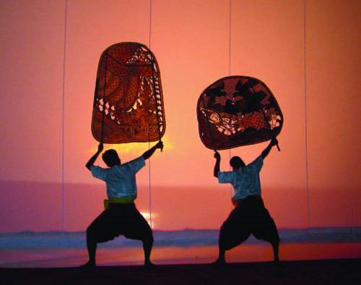
Community participation WHY?
People enact and transmit ICH, and identify with it (Art. 2.1)
They carry with them the knowledge and skills for enacting and transmitting (Art. 2.1)
Safeguarding is continued practice and transmission by them (Art. 2.3)
Any safeguarding will fail without their participation and consent (Art.15)
Sbek Thom shadow theatre © National Museum of Cambodia

Slide 5
What the Convention and the ODs say (and don’t say)
Involve the communities, groups and individuals concerned in safeguarding actions and other activities concerning their ICH (Article 15)
Prove the free, prior and informed consent of these communities in some cases (OD 1, 2, 7, 101(b))
But no specific guidance on HOW to identify communities of how to involve them in safeguarding their ICH

Slide 6
Roles of States and rights of Communities
The Convention is an agreement between States
It does not impose obligations on communities
Convention and ODs request States Parties to involve and assist communities, where necessary, if they wish to identify and safeguard their ICH (Article 11(b), 15).

Slide 7
Community participation in what?
Identifying and defining (Art. 11(b))
Inventorying (Art.12, 15);
Awareness raising (Art.14 , 15);
Capacity building (Art.14 , 15);
Safeguarding, management (Art.15) ;
Nominations (OD 1, 2, 7);
International assistance requests (OD 12); and
Periodic reporting (OD 157, 160).

Slide 8
Community participation in identification, inventorying and safeguarding
Central tenet of the Convention
Increasingly central also to the management of tangible heritage
Not always easy to implement

Slide 9
Community participation in inventorying
“... what is really needed is for the community to participate in the process [of inventorying]... If the inscription takes place without dialogue with the community ... I wonder whether there will actually be any involvement in safeguarding ...”
Dr Londres Fonseca (IPHAN - Brazil)
Notes:
Fonseca interview clip: “In my own opinion, what is really needed is for the community to participate in the process [of inventorying], because otherwise our vision is going to be too remote from what is actually happening and we shall fail to realize that the name and category of the element are not the only thing that matters. What matters above all are its meanings, the values attributed to it and how people practise it, which varies a lot. These are older people, and, of course, an anthropologist’s view helps a lot, but I doubt whether the anthropologist’s view is enough. No doubt an anthropologist is very helpful and knows the methodology, but the problem is not just description, because for us an inventory is the first step towards safeguarding. If the population takes part in the inventory, if the community is involved, it has already become a partner in this process. If the inscription takes place without dialogue with the community, even if there is a formal gesture in this direction, I wonder whether there will actually be any involvement in safeguarding or whether this involvement will have to be built afterwards. This is not impossible, but I think it is better to do it beforehand if possible. However, I realize that scale is something very complicated here, and I think that each country must find its own answers.”

Slide 10
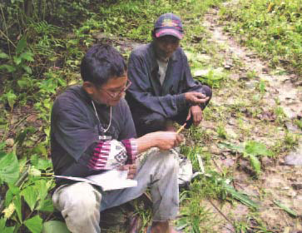
Documenting Subanen indigenous knowledge (Philippines)
Elders recognized that their knowledge about local plants was not being passed on to younger community members
They asked for help to train young people to document this knowledge within the community
Copyright protection gained
Materials included in the school curriculum
A Subanen member of the
documentation team receiving
information from an older member
of the community.

Slide 11
Community participation in awareness-raising
The ODs encourage States Parties to ensure community participation in awareness raising about their own ICH (OD 101(b)),
And to obtain their free prior and informed consent for it to happen (OD 101(b)).
This can help to ensure that communities and their ICH are not misrepresented in or disadvantaged by awareness-raising activities (OD 102).

Slide 12
Community participation in nominations and international assistance requests
Proof is required of:
Community participation in:
- identification of the ICH concerned (Article 2.1, OD 1, 2)
- preparation of the files (OD 1, 2, 7, 12)
Community consent for submission of nominations (OD 1, 2, 7)
Community commitment to safeguard the element, if appropriate (OD 1)

Slide 13
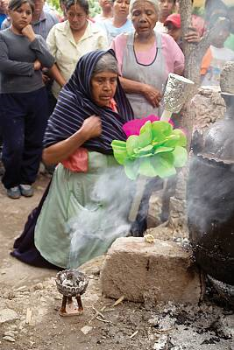
Traditions of the Otomí-Chichimecas (Mexico)
Community consultation meetings and opinion poll
Safeguarding proposals come from the community
Regional forum and community declaration
Representative management / safeguarding body established
© 2007 Government of the State of Queretaro

Slide 14
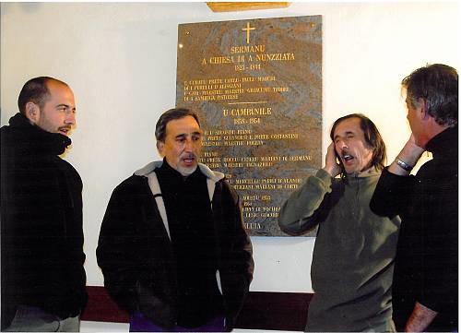
Cantu in Paghjella nomination (Corsica/France)
Polyphonic singing
Expert-practitioner meetings
Formation of a practitioner association
Practitioner involvement in inventorying
Media campaigns
© Michèle Guelfucci-Glinatsis, 2009

Slide 15
Traditions of the Mijikenda (Kenya)
Traditions and practices associated to the Kayas
Community consultations
Incorporating community ideas into the safeguarding plan
Community development groups formed.

Slide 16
Mechanisms of community participation and consent
Who is the community?
Who represents them, with what mandate?
How can they be informed and involved?
How can safeguarding measures be developed with their involvement and consent?
Who may and should be involved in the implementation and monitoring of safeguarding measures?

Slide 17
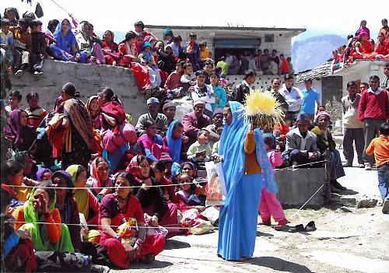
Identifying the communities concerned
Those who participate in the practice, development and/or transmission of one or more ICH elements, and consider it part of their cultural heritage.
Note: communities can also be defined in other ways.
Ramman: religious festival and ritual theatre of the Garhwal Himalayas, India © IGNCA, Ministry of Culture

Slide 18
Identifying community representatives
The need for representatives
Existing representatives, or not?
Mandate and legitimacy of representatives
Different views within communities

Slide 19
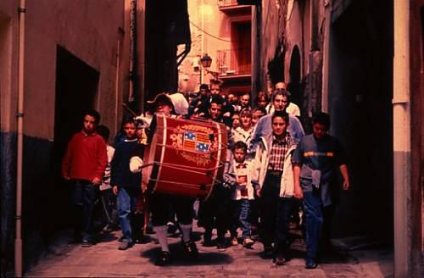
Case Study: The Patum of Berga
The Patum of Berga (c) Manel Escobet i Giro / UNESCO
Notes:
http://www.unesco.org/culture/ich/en/RL/00156

Slide 20
Community participation
Through: workshops, meetings, consultations, polls, media, capacity building, awareness raising, etc.
For: identification of elements, their value and viability, need and feasibility of safeguarding, actions foreseen under the Convention, etc.

Slide 21
Free, prior and informed consent
‘Prior’ - the information required to consider whether to give consent or not, was given in advance;
‘Informed’ – all relevant information required for making a balanced judgement was provided;
‘Free’ - no undue pressure was exerted on those whose consent was sought.

Slide 22
Protecting the rights of communities
that the rights of communities, groups and individuals are duly protected when raising awareness about their ICH or engaging in commercial activities
(after OD 104).
States Parties should try to ensure …

Slide 23
Ensuring communities benefit
Practising ICH brings benefits to communities; so can safeguarding activities
Communities’ capacities to manage their ICH should be enhanced (OD 107(m))
Communities should benefit from awareness-raising activities (OD 101(d))
Communities should be the primary beneficiaries of any commercial activities (OD 116)

